Slide 1
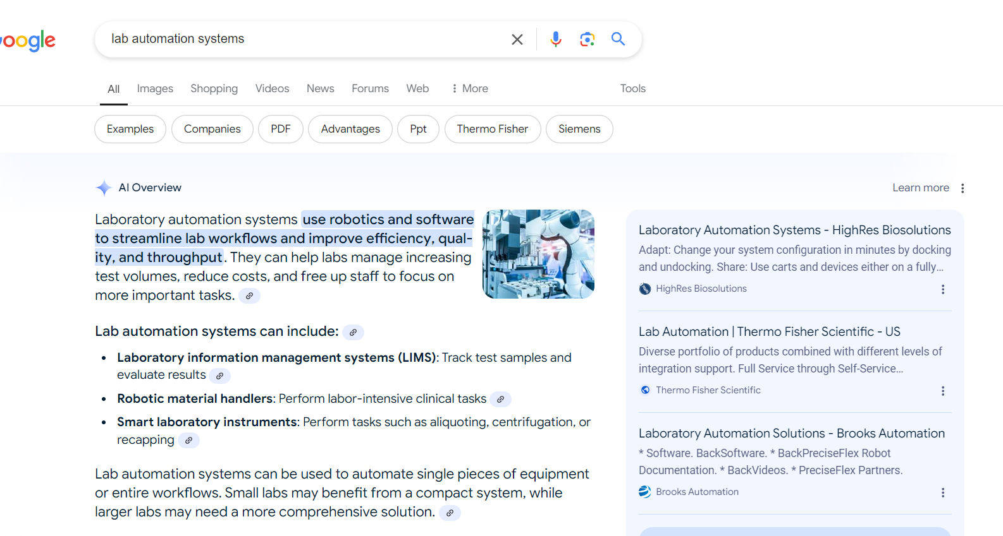
HighRes Biosolutions
AI Search relevancy for key search terms
SEO & AI Overview Support
Affirma has provided HighRes the following SEO support services to increase brand awareness and lead gen as well as remain the leading authority in lab automation:
SEO strategy & best practices
Competitor and keyword research
Technical & on-page SEO
Off-page SEO
Content briefs
Support expanded to include AI Search strategies to meet the evolving search landscape.
Managed Service:
Full-service digital marketing support with consistent team of 6+ resources.
About HighRes
HighRes Biosolutions designs and builds innovative robotic systems and laboratory devices used in pharmaceutical, biotech, and academic research for automation of workflows, particularly in areas like drug discovery, genomics, and biorepository science.
Locations:
Global remote with ad-hoc on-sites
Contract:
1 year w/ annual renewals since 2021
Notes:
Alyson

